Slide 1


The Julia Programming Language
Pattern Recognition Course
Optional Material
Prepared by Essam Wisam

Slide 2
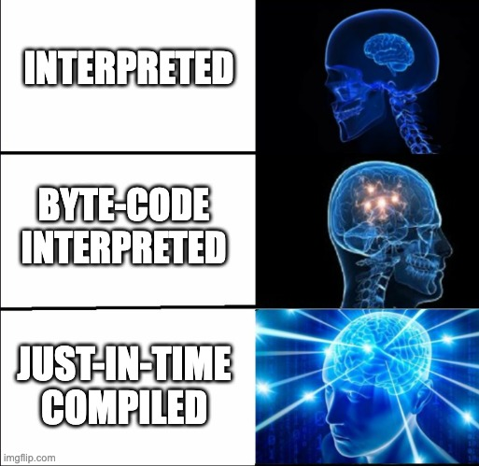
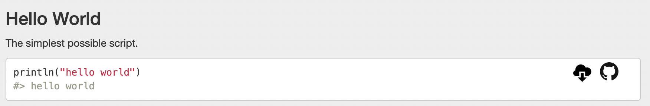
Julia Intro
Julia is:
High-level
General-purpose
Dynamically and strongly typed
Just-in-time Compiled
Before adding to resume:
Fairly new: 1st major release in 2018

Slide 3
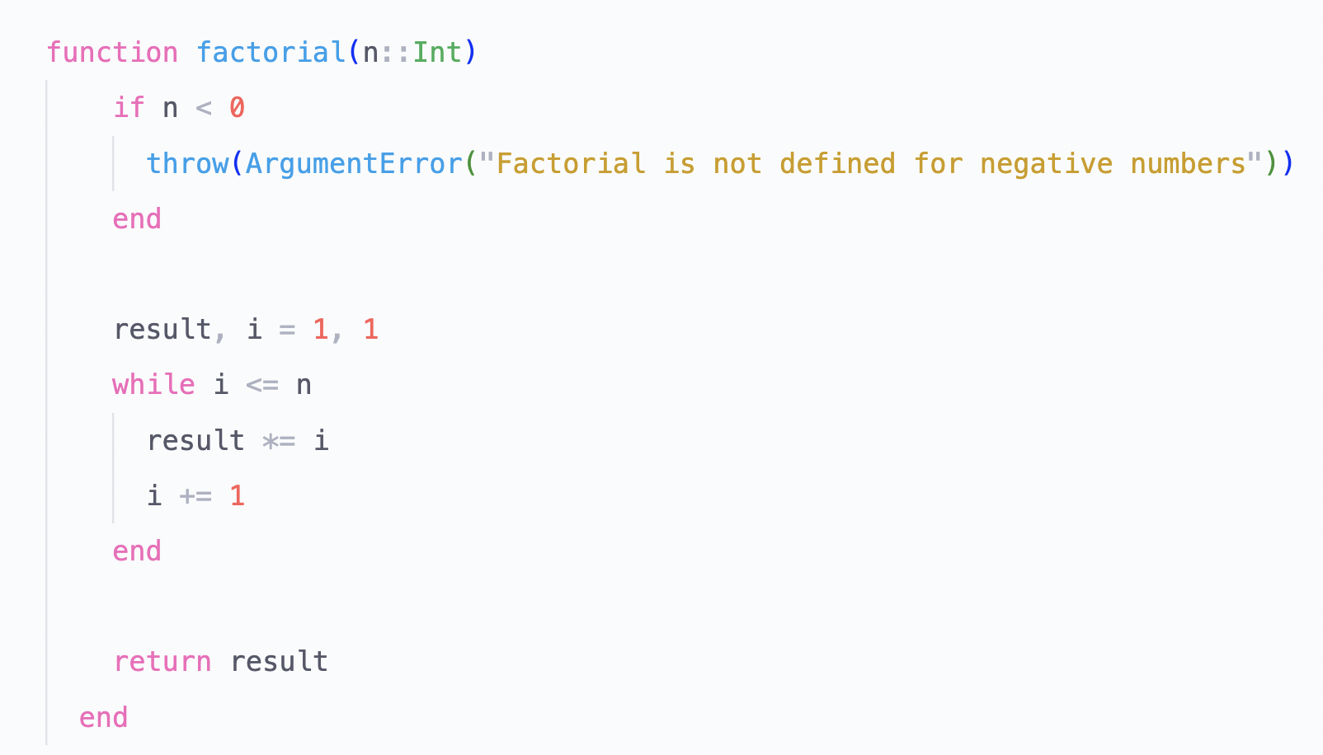
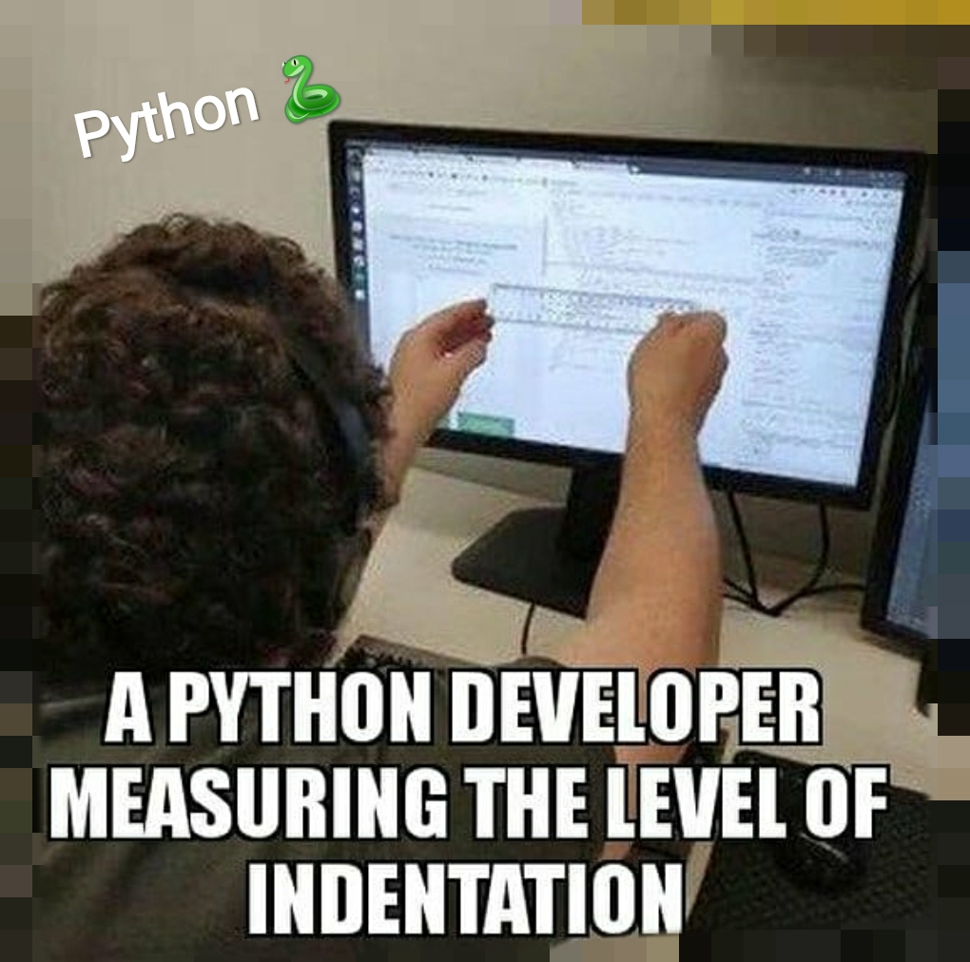
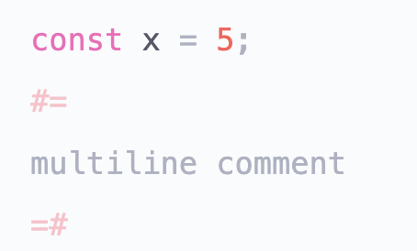
Julia is High-Level
Real Types!
Syntax ≈Python
Symmetry is back
Constants and Multiline Comments as well!

Slide 4
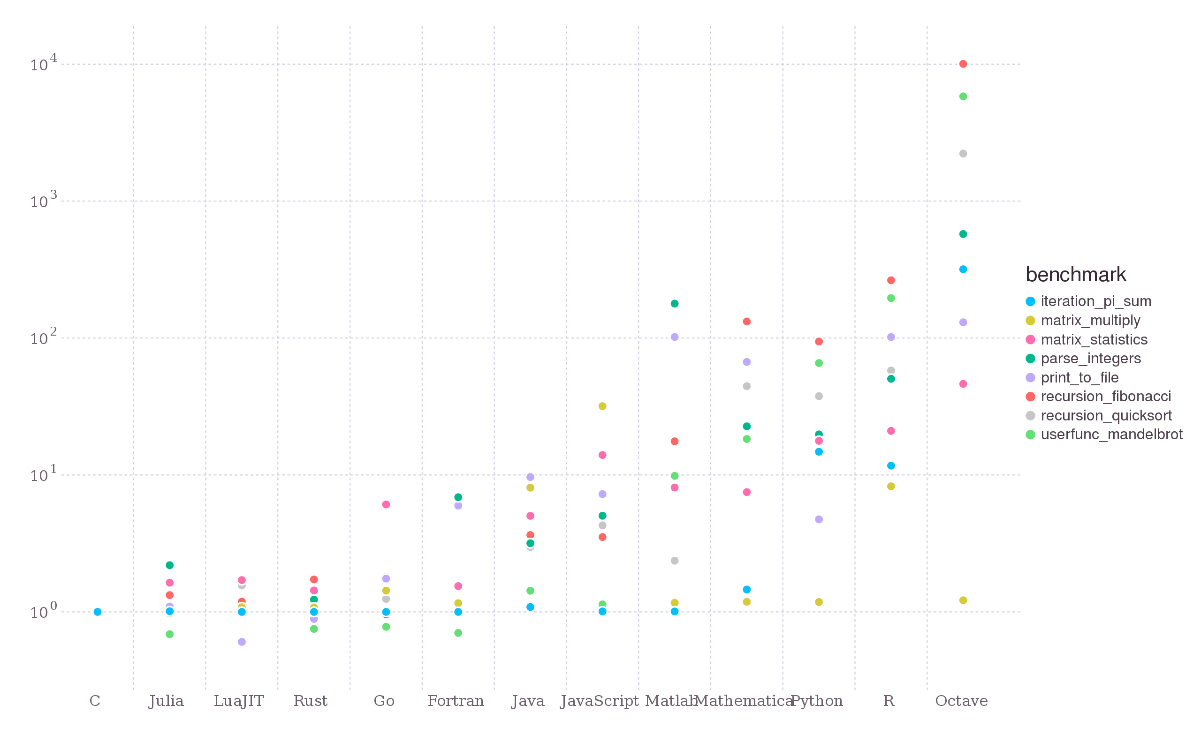
Julia is Fast
Thanks to being JIT compiled and type system
High-level + Fast → Solves the Two Language Problem
Built-in Multithreading!

Slide 5
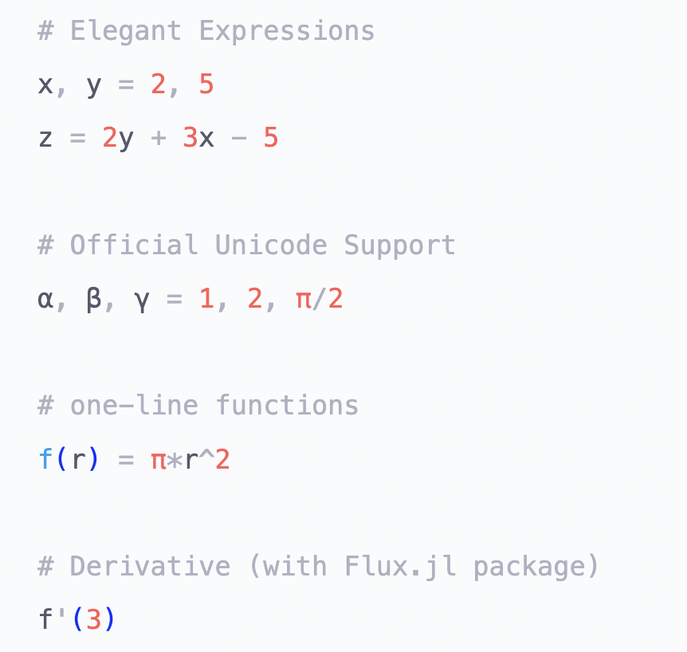
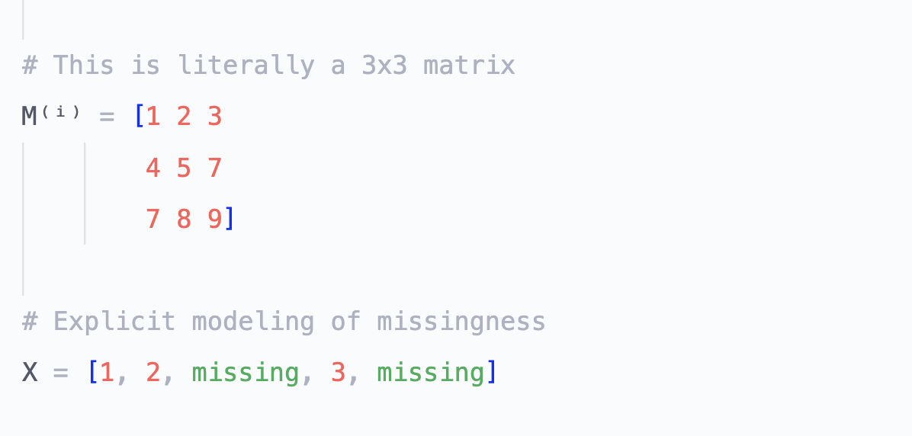
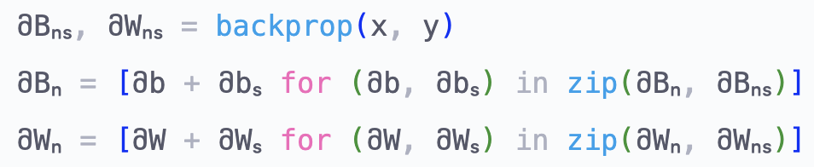
Julia is Mathematically Elegant

Slide 6
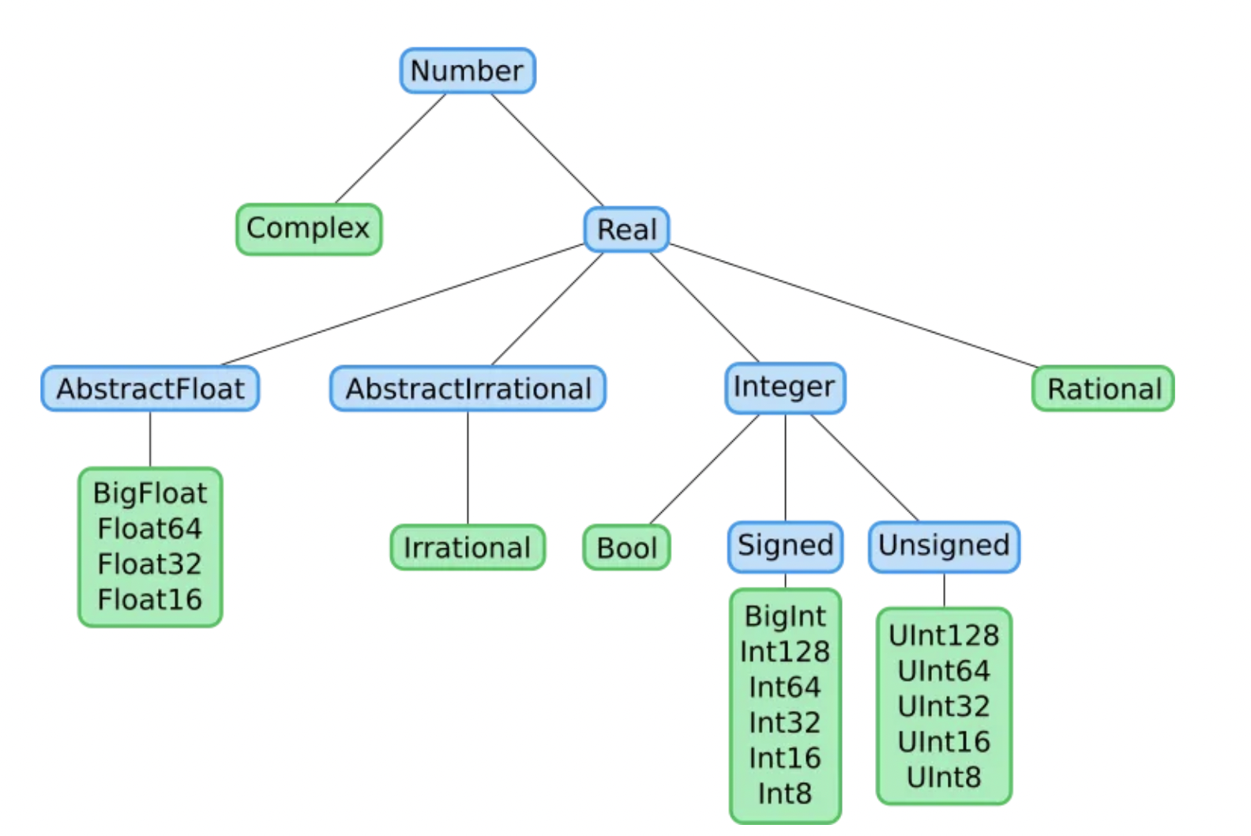
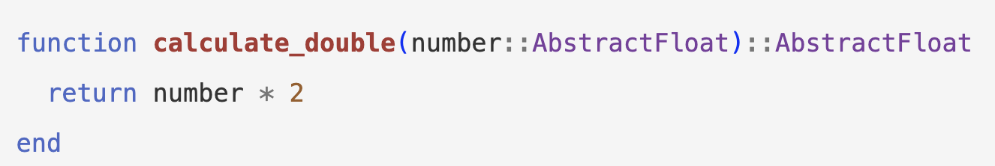
Julia is Mathematically Elegant
Abstract Types
Concrete Types
Other types are much simpler
Numeric Types

Slide 7
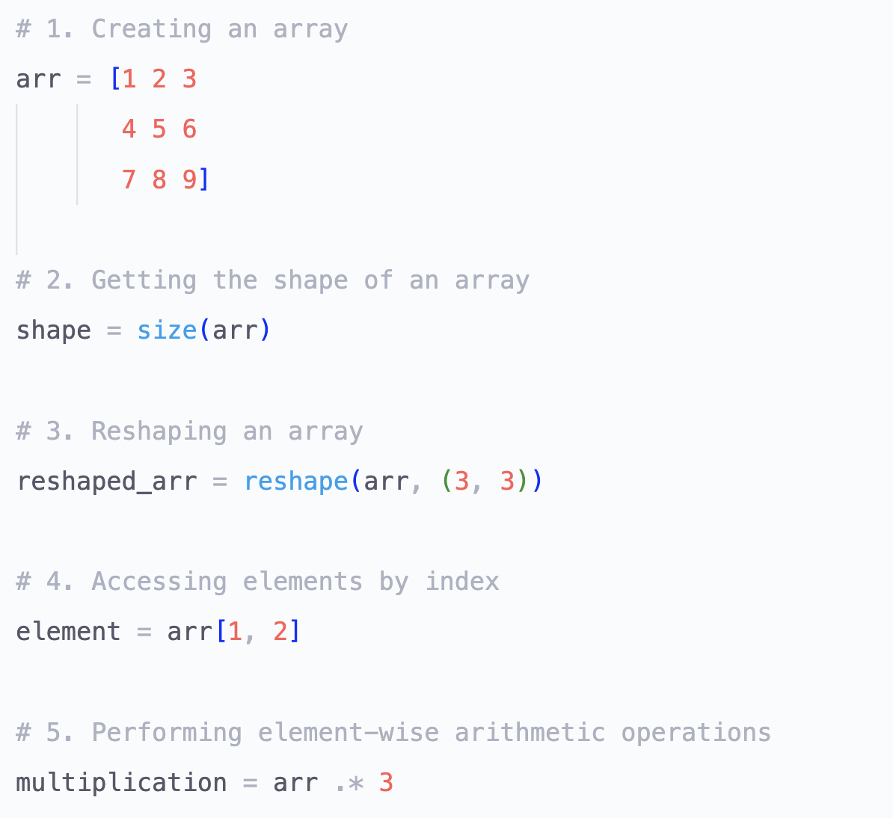
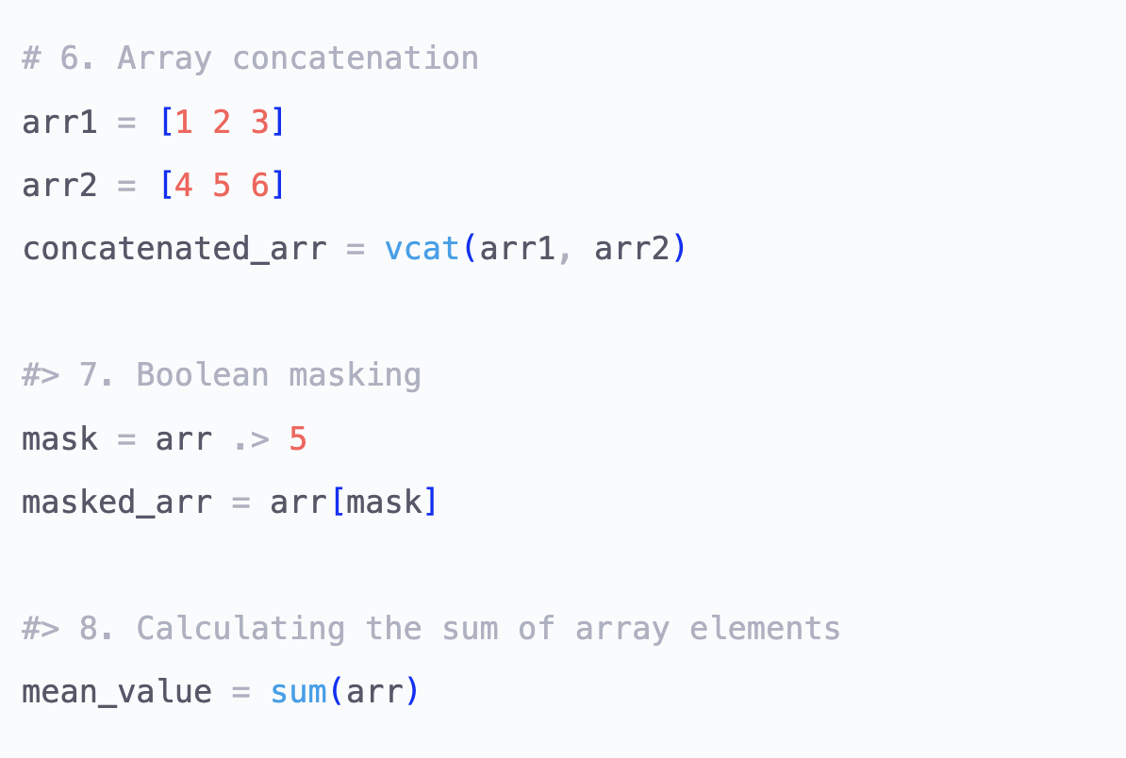
Julia is Fully Featured
Numpy operations are built-in!
Also standard packages for tests, package management, big data, etc.

Slide 8
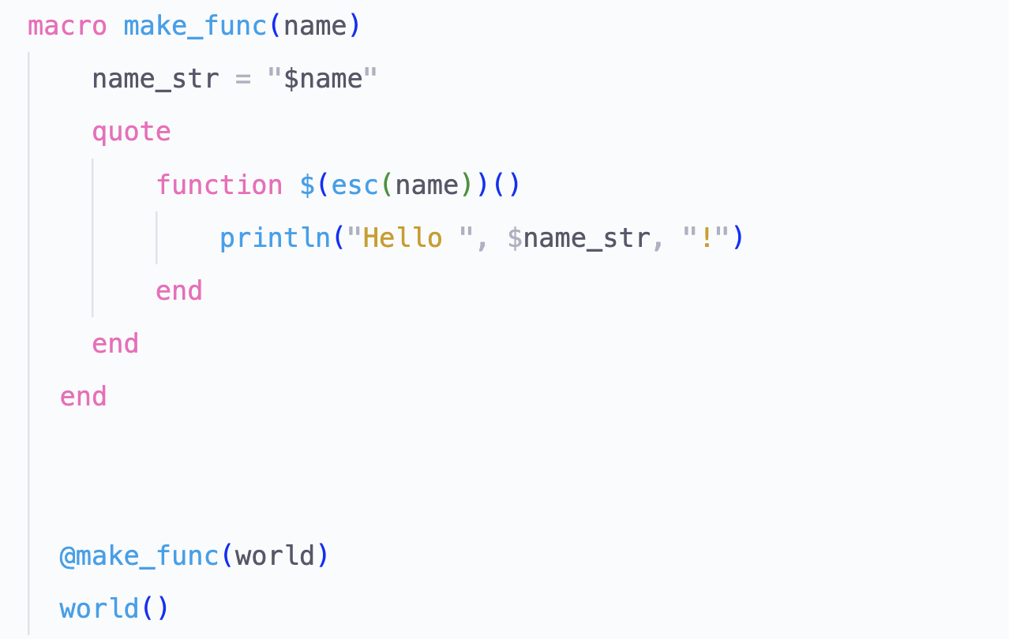

Julia is Homoiconic
Makes a function with the template above.
Generate code to write less!

Slide 9
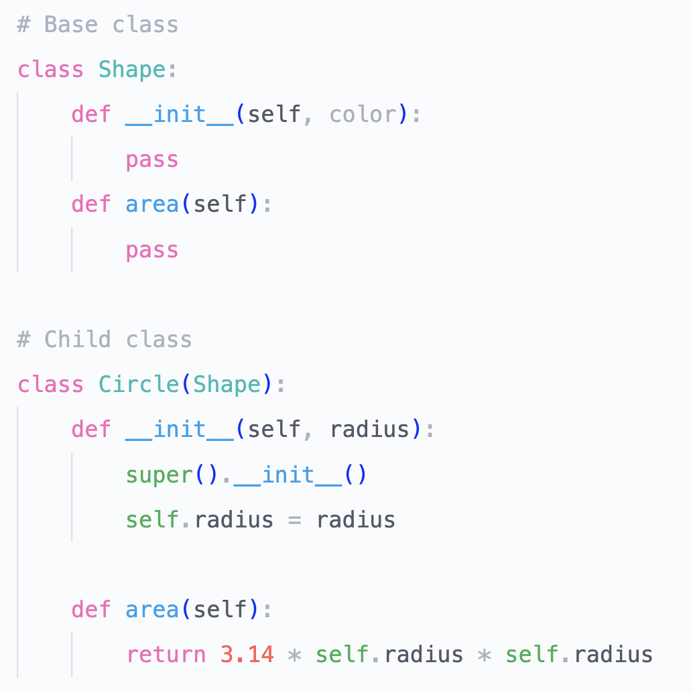
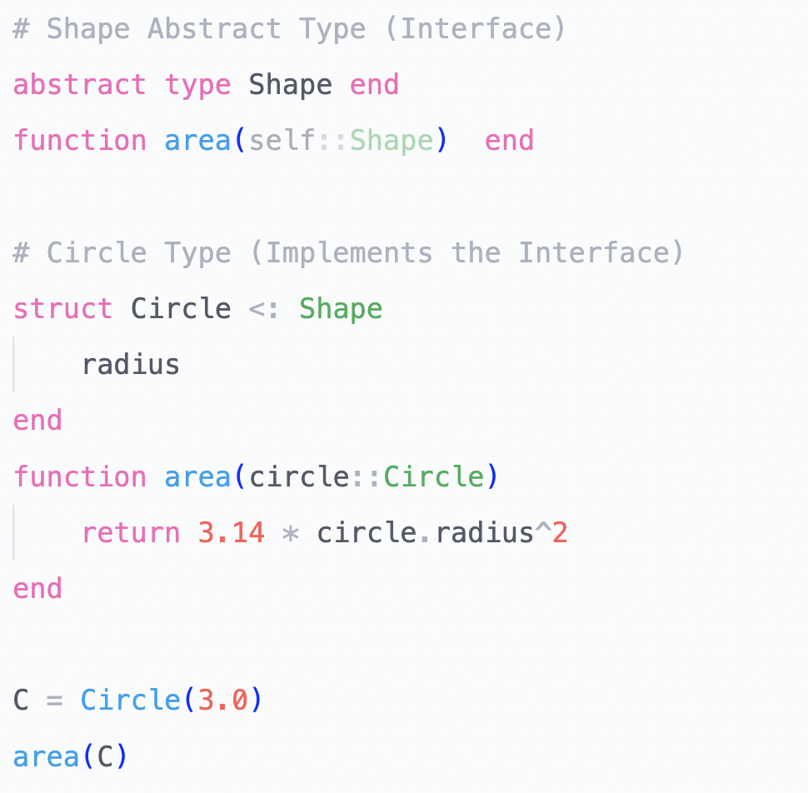
Julia is Multiple Dispatched
Elegantly add new types ✅
Elegantly add methods ❌
Elegantly add new types ✅
Elegantly add methods ✅

Slide 10
Thank You

